Slide 1
Coursera Capstone Project - London Freelance Office Location
Author: Robert Kwiatkowski Date: 16/01/2020

Slide 2
Problem
Finding an optimal location for a freelancer/contractor with the following assumptions:
Moves alone or with a partner (no children, one-bedroom apartment)
Works remotely or has a parent company very close (distance to company is not relevant)
Want to rent a flat/house (not to buy)
Does not want to commute much for shopping
Prefers eating out to cooking at home
Does not want to overpay for a place (cost-aware person)

Slide 3
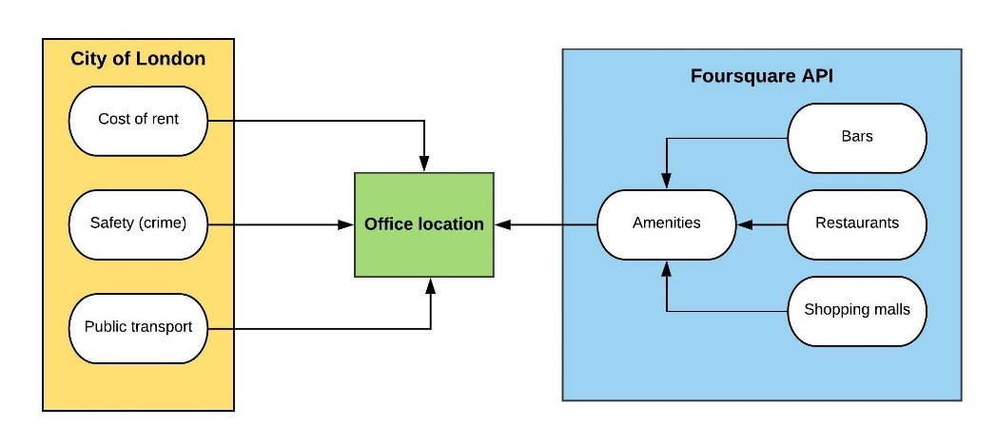
Decision criteria
Three main decision criteria:
Safety
Costs of living
Attractiveness
Two main data sources:
City of London
Foursquare API

Slide 4
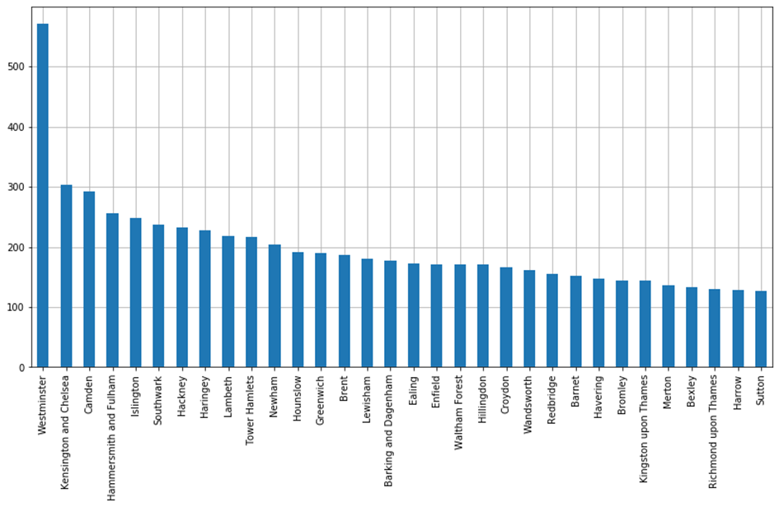
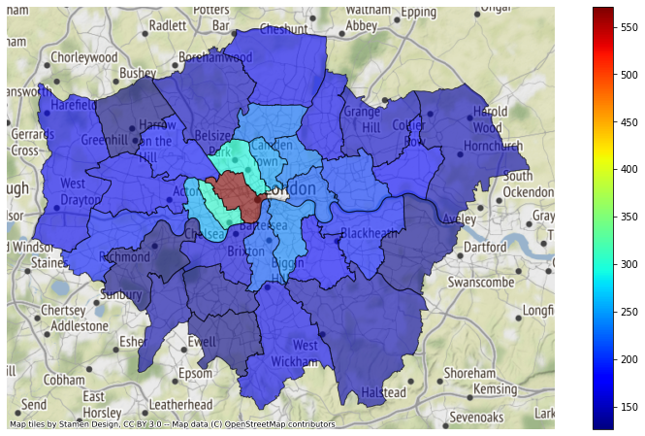
Safety - Crime
Best locations: Richmond upon Thames, Harrow and Sutton

Slide 5
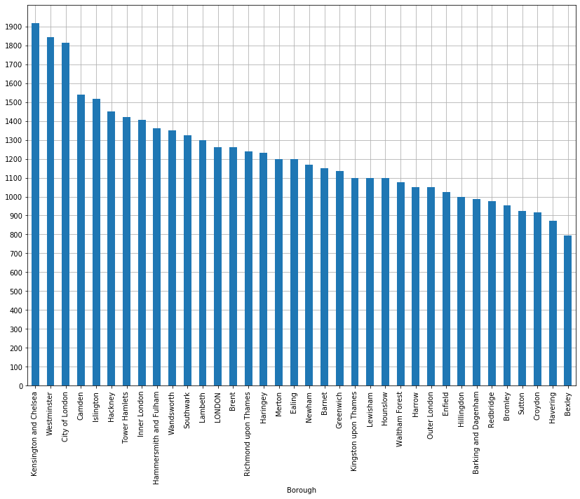
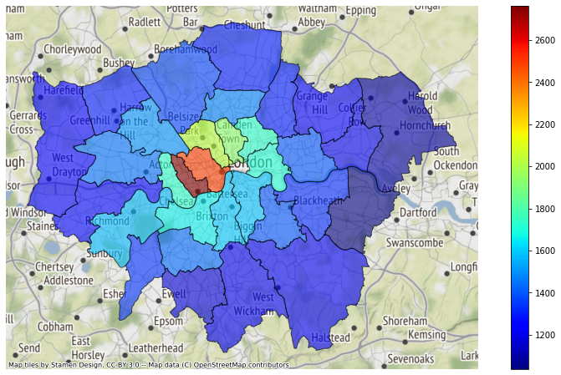
Rent cost
Best locations: Bexley, Havering and Sutton

Slide 6
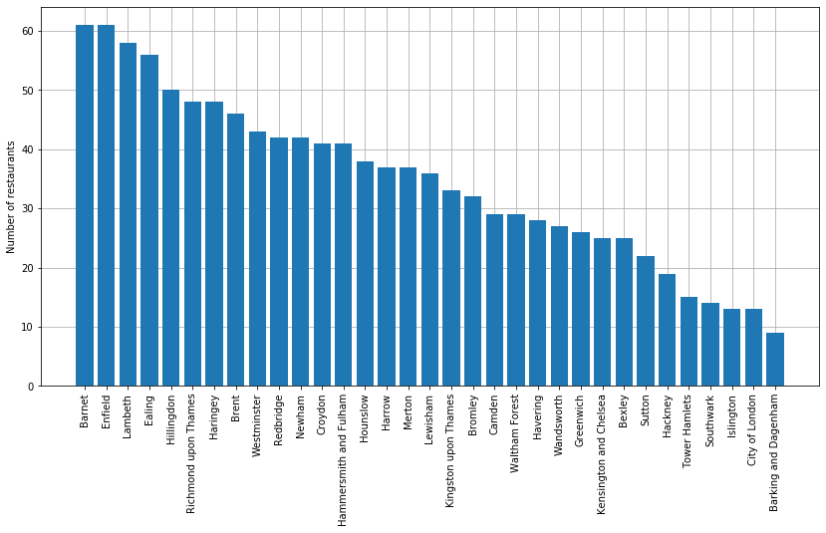
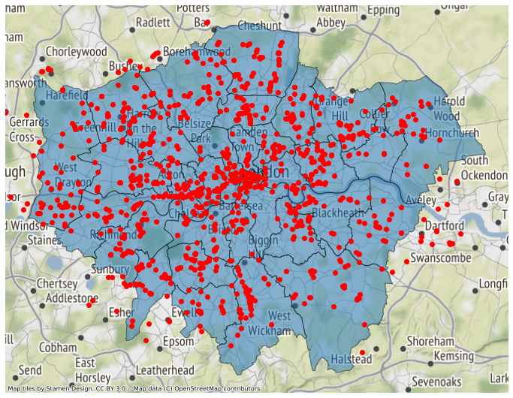
Restaurants locations
Best locations: Barret, Enfield, Lambeth and Ealing

Slide 7
Results and discussion
Based on the performed analysis the following boroughs are recommended:
Ealing
Enfield
Lambeth
These three borough offer a good balance between costs of living, safety and location attractiveness
Results of this analysis will change with new set of assumptions
Further improvements:
Increase number of decision factors
Analyse safety data more in details by separating light and hard crimes
Assess attractiveness of each area based on more specific requirements based on personal preferences

